Slide 1
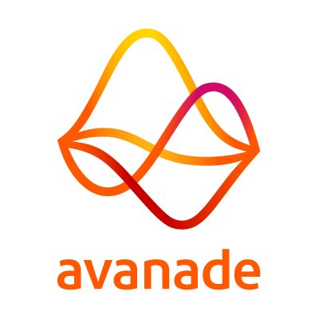
Avanade Task
Implemented by Manikanta, Abotula

Slide 2







Task Flow
Data Factory
Azure Storage
Data Factory
Data Lake Store
Data Lake Store
Data Lake Analytics
Azure Storage
Data Factory
Azure DB
Analysis Services
Power BI

Slide 3
Azure Resources :
Storage Account
Azure data lake store
Azure data factory
Azure data lake analytics
Azure Data Base
Azure Analysis Services
Azure Virtual Machine
AAD Application
Skills:
Azure
U-SQL
Power Shell
JSON
SQL
DAX
Power BI
Environment Setup:
Created Azure free Account
Created Azure VM for Development Task
Installed Azure Power Shell in VM
Installed Power BI Desktop in VM
Installed SSMS in VM
Data Preparation

Slide 4
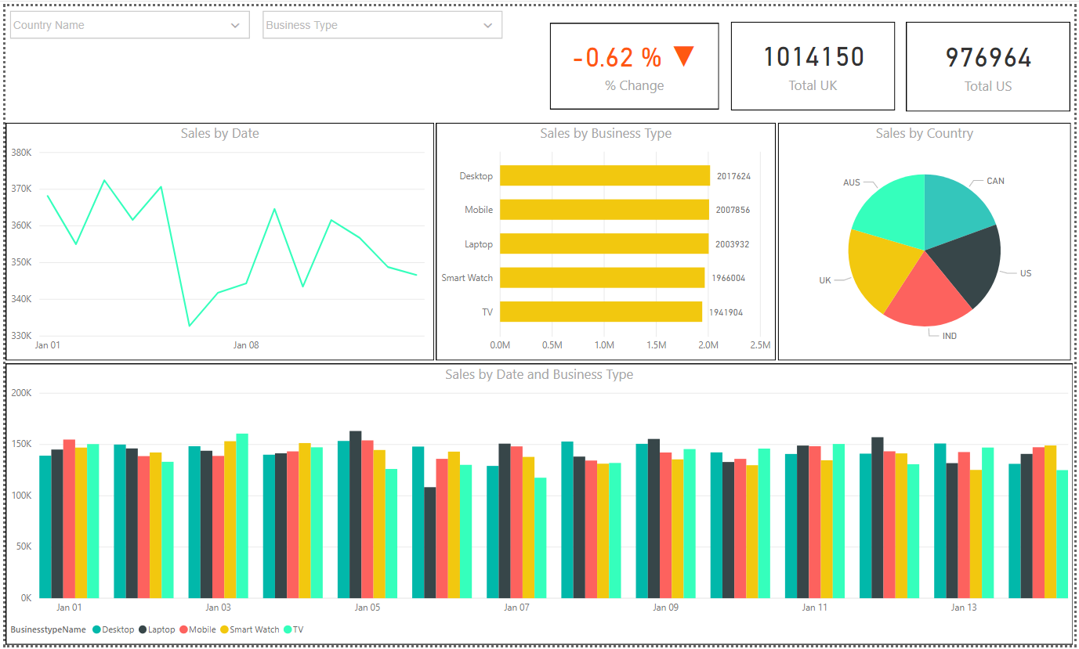

Slide 5


Slide 6


